Slide 1
Collaborating with Microsoft 365

Slide 2

Collaborating with a modern team.

Slide 3

Collaborating with a modern team.

Slide 4

Collaborating with a modern team.

Slide 5

Courtney Hodge
Program Manager of Inclusive Learning

Slide 6


Microsoft Teams
SharePoint

Slide 7
Collaborating with Microsoft 365

Slide 8
Why Use Teams?

Slide 9
In this lesson:
Using Teams to engage and collaborate

Slide 10

Try out Teams
Communicate quickly
Share files easily
Useful program integrations

Slide 11
Create a Team

Slide 12
In this lesson:
Making a Team

Slide 13
Create a Team
Use a Template
Set privacy level
Give descriptive name
Customize channels

Slide 14
Add Team Members

Slide 15
In this lesson:
Adding team members and managing roles

Slide 16
Build Your Team
Add team members
Assign roles

Slide 17
Manage Team Settings

Slide 18
In this lesson:
Setting permissions

Slide 19
Manage your team settings
Add and remove owners
Limit member permissions

Slide 20
Adding a Channel

Slide 21
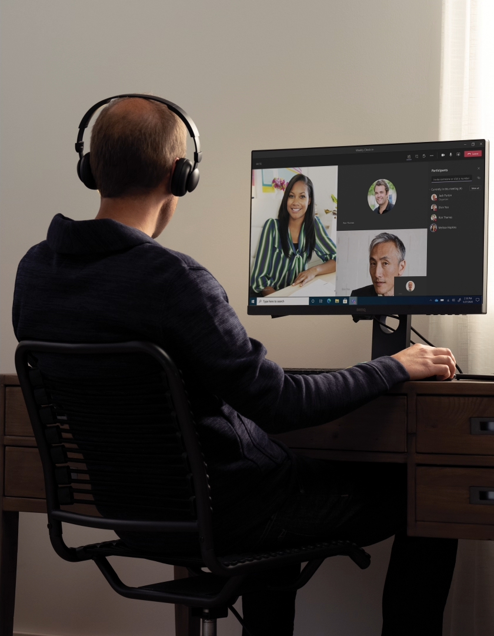
Channels
Organize files
Organize communications
Connect team members

Slide 22
In this lesson:
Customizing channels

Slide 23
Customize a channel
Create a channel
Adjust privacy level
Add members to a channel

Slide 24
Chatting with Teams

Slide 25
In this lesson:
Sending messages in Teams

Slide 26
Communicate in Teams
Message team member
Start a group chat
See updates in activity feed

Slide 27
Making a Call in Teams

Slide 28
In this lesson:
Making phone calls in Teams

Slide 29
Make calls in Teams
Call from a chat, history, or contacts
Choose video or audio call

Slide 30
Working with Messages in Channels

Slide 31
In this lesson:
Messaging in Teams

Slide 32
Send a Message in Teams
Post publicly in a channel
Message privately in chat

Slide 33
Using Formatting in a Post

Slide 34
In this lesson:
Formatting a post in Teams

Slide 35
Create a Post in Teams
Post conversation in a channel
Customize format of post
Apply text formatting

Slide 36
Creating New Files and Folders in Teams

Slide 37
In this lesson:
Adding folders to Teams

Slide 38
Organizing Files in Teams
Create new folder
Create new file

Slide 39
Use folders in Teams
Create a folder in a channel
Upload files
Share your folder

Slide 40
Attaching and Uploading Files to a Channel

Slide 41
In this lesson:
Sharing files in a post and from the file tab

Slide 42
Share files with your team
Attach a file in a channel
Upload a file using the files tab

Slide 43
Adding Tabs

Slide 44
In this lesson:
Adding tabs to channels in Teams

Slide 45
Add tabs to your team
Create tab from a file
Turn an app into a tab

Slide 46
What is SharePoint?

Slide 47
In this lesson:
Understanding SharePoint

Slide 48
Try out SharePoint
Create a website
Store and organize information
Share information

Slide 49
Creating Your First Team Site

Slide 50
In this lesson:
Creating Team Sites in SharePoint

Slide 51
Create your team site
Store, organize and share information
Access from any type of device

Slide 52
Creating Your First Communication Site

Slide 53
In this lesson:
Creating SharePoint communication sites

Slide 54
Build Your Own Communication Site
Create SharePoint site
Apply a site template
Add content

Slide 55
Working with Files in SharePoint

Slide 56
In this lesson:
Managing file structures and sharing files

Slide 57
Add files to SharePoint
Create a folder
Share with collaborators
Upload files to folder

Slide 58
Adding Engaging Content to Your Site

Slide 59
In this lesson:
Sharing dynamic content in SharePoint

Slide 60
Create an engaging site
Change site layout
Adjust sections
Add and format web parts

Slide 61
Sharing and Collaborating with SharePoint

Slide 62
In this lesson:
Working together in SharePoint

Slide 63
Collaborate in SharePoint
Add new members
Update permissions
Share your site

Slide 64
Collaborating with Microsoft 365

Slide 65
Collaborating with Microsoft 365

Slide 66
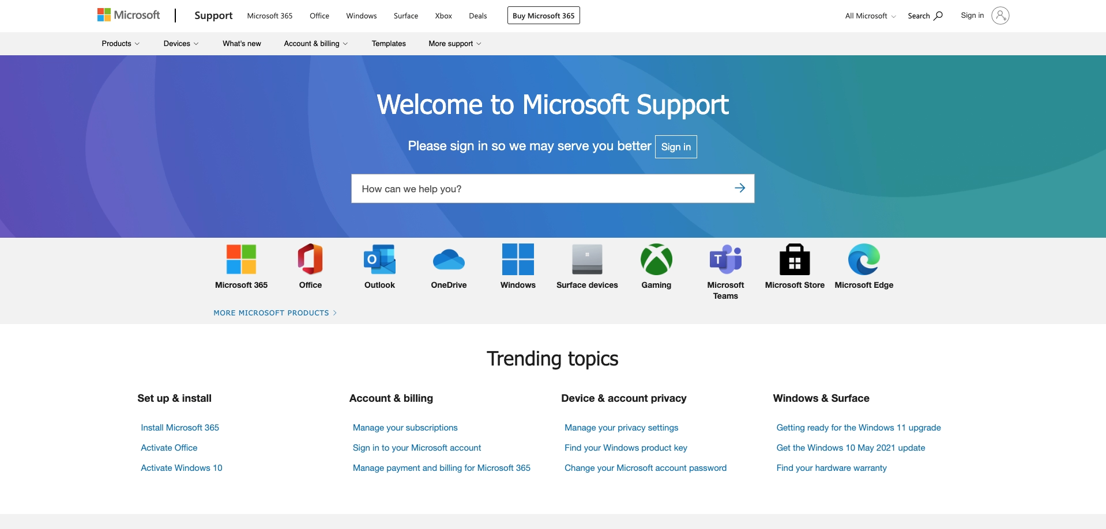
https://support.microsoft.com/en-us

Slide 67

https://www.microsoft.com/en-us/store/workshops-training-and-events

Slide 68
Collaborating with Microsoft 365

